Slide 1

Salesforce Developer Virtual Internship
Presented by:
S.Rakesh Kumar
Computer Science and Engineering
Enrollment Number: 21CS002373
Supervisor: Mr. Shivam Upadhyay (Salesforce.com)

Slide 2
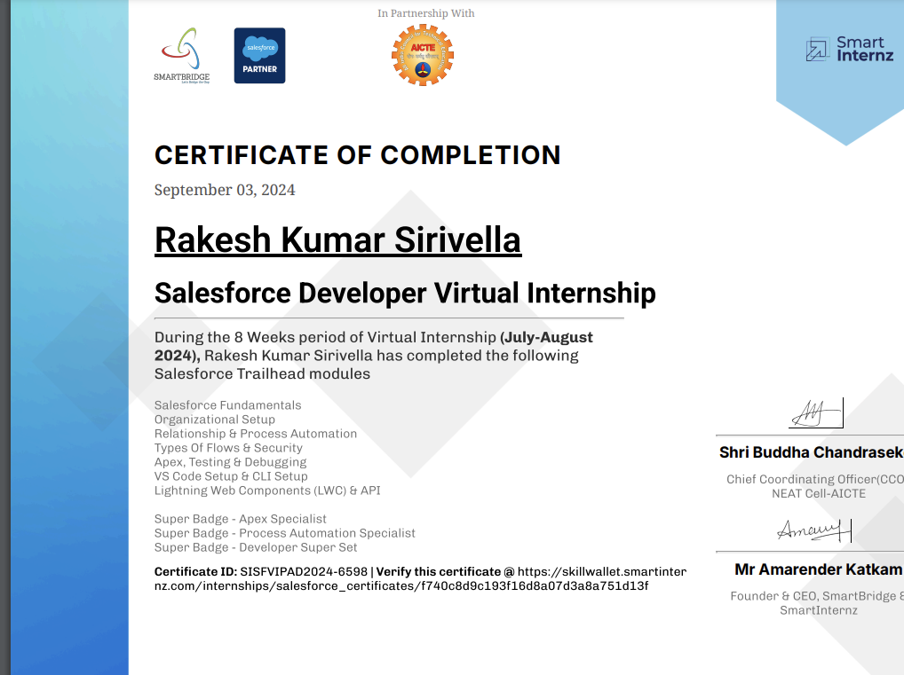
Internship Certificate

Slide 3
Introduction
Company Name : Salesforce
Brief Description : Salesforce is a cloud-based software company specializing in Customer Relationship Management (CRM) and enterprise applications focused on customer service, marketing automation, and analytics.
Overview of the Internship Program : A virtual program focused on Salesforce development, covering Apex, Visualforce, and Lightning.
Importance of the Internship: Gained hands-on experience in CRM application development and cloud platforms.

Slide 4
Internship Objectives
Duration: 1 Month 21Days (July 10th - August 31st )
Location: Remote
Internship Type: Part-time
Company's Expectations: Develop, configure, and maintain Salesforce applications, familiarizing with Apex and Lightning.
Internship Objective: Successfully developed functional Salesforce applications and gained CRM system experience.

Slide 5
Key Project & Responsibilities
Project Title: CRM Enhancement Project
Brief description : Enhanced CRM for improved customer data management and automated processes.
Your role and contributions : Worked on coding using Apex and Visualforce, automated workflows with Process Builder.
Technologies/Tools used : Apex, Visualforce, Salesforce Lightning, Process Builder.
List of Skills: Salesforce development, Apex, Visualforce, Lightning, Cloud Computing.
Outcomes/results: Achieved a 20% improvement in data processing efficiency.

Slide 6
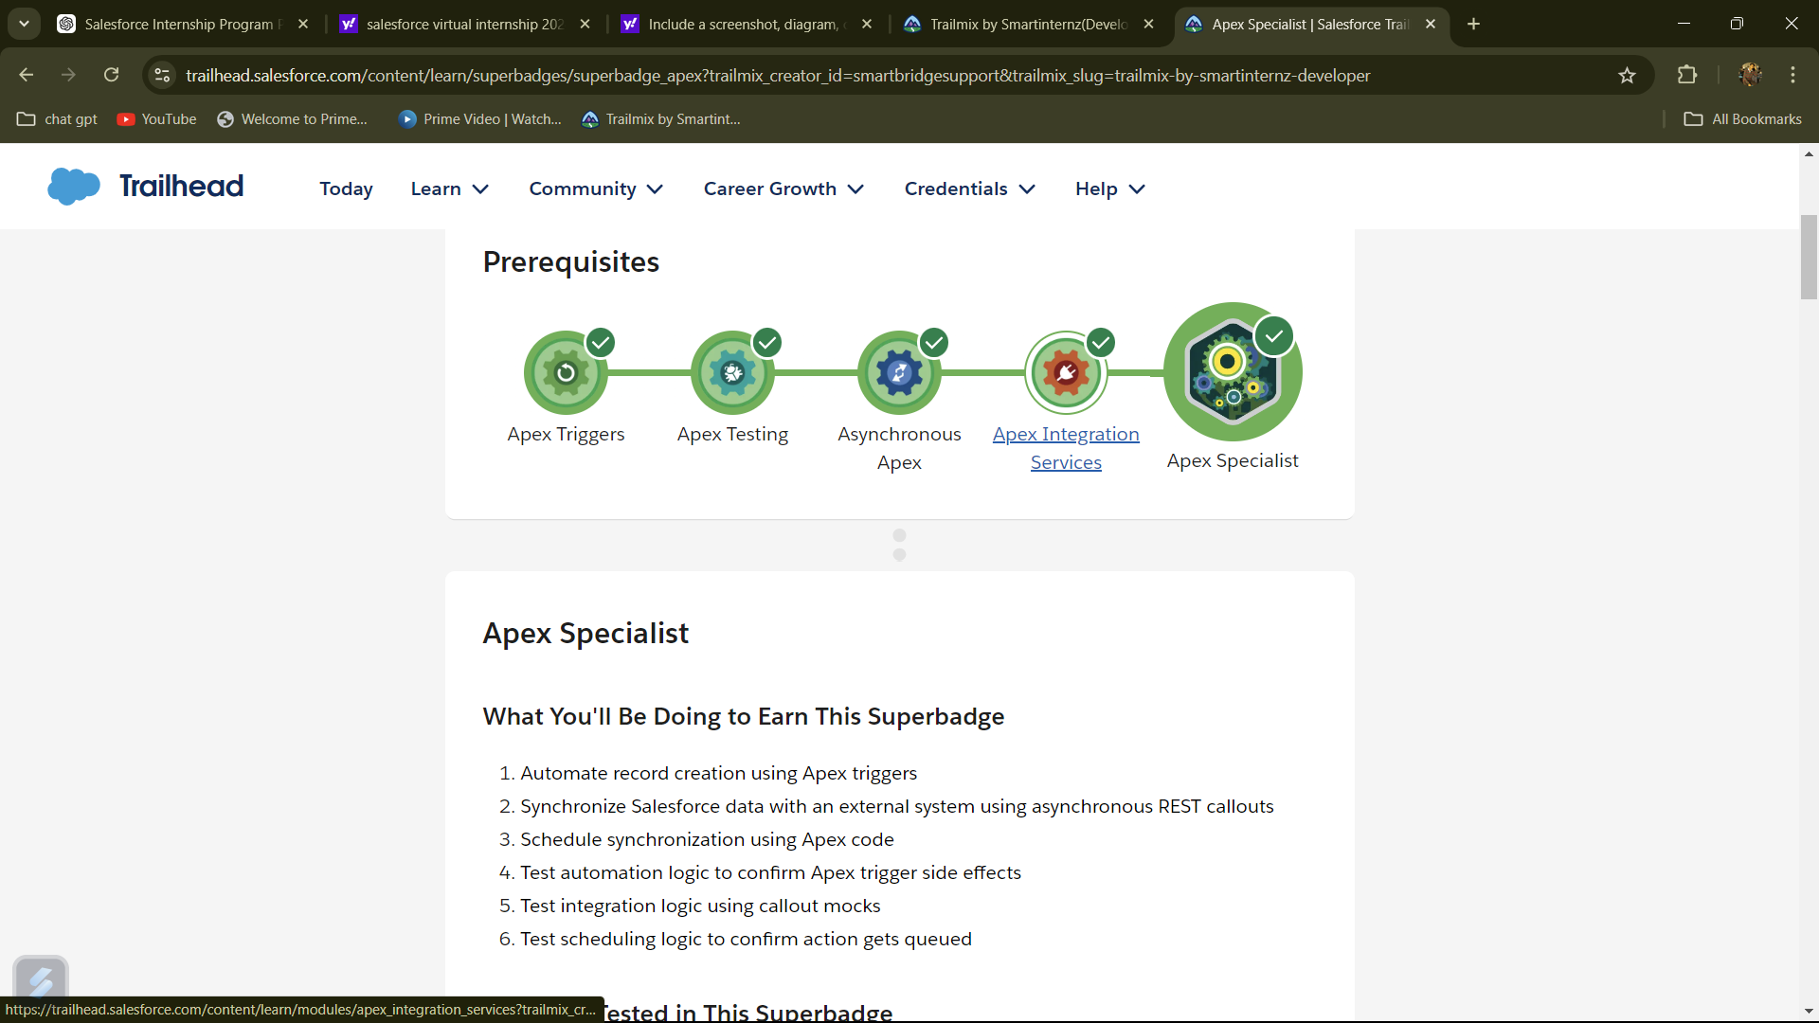
Project Description
Project Description: Developed enhancements for Salesforce CRM, focusing on automation and better data handling.
Focus on impact: Streamlined processes, reduced manual input, and improved data accuracy.
Key Achievements/Outcomes: Automation led to a 20% increase in efficiency. Delivered real-time reports and dashboards.
Visuals:

Slide 7
Lessons Learned
Key Takeaways:
- Mastery of Salesforce development tools (Apex, Visualforce, Lightning).
- Improved understanding of CRM architecture.
- Experience in virtual teamwork.
Challenges Overcome: Overcame the Apex learning curve through practice and mentorship.

Slide 8
Conclusion and Results
Successfully enhanced the CRM(Customer Relationship Management) system, meeting company objectives.
Improved workflow automation and data accuracy.

Slide 9
Future Work
Next Steps:
- Further learning in Salesforce Lightning
- Certification in Salesforce Administrator or Developer.
- Continued CRM solution development.
- Expand knowledge in cloud technologies.
- Pursue advanced Salesforce projects.

